Slide 1
MSDA DATA 621 Final project
Critical Thinking Group -2
Sekhar Mekala, John DeBlase & Sonya Hong

Slide 2
Agenda
Data set description
Objectives, methodologies and assumptions
Boosted Regression Trees
Rule fit model
Challenges
Results
Future work
Questions
Additional information

Slide 3
Dataset description
Allstate dataset posted at Kaggle.com
Training data set
Rows: 188318, Variables: 131 (excluding ID variable)
116 Categorical variables and 14 continuous variables and one Target variable
Most of the categorical variables have less than 5 levels, but some have more than 50 levels, 326 levels being the highest
Size: Approximately 70MB
Test data set
To predict the Target variable for evaluation by Kaggle
Rows: 125546, Variables: 131
Size: Approximately 45MB

Slide 4
Objectives, methodologies and assumptions
Objectives:
To accurately predict the target variable (loss).
Identify the significant variables that are related to the target variable
Select the algorithm that has the minimal Cross Validation error in a reasonable runtime of the algorithms
Methodologies (Ensemble methods):
Boosted Regression Trees or BRT [1]
Rule Fit ensembles [2]
Assumptions:
Given that the data set has many categorical variables, with many levels, we assumed that a linear model is not suitable for this data set (since addition of dummy variables to handle all categorical variables would introduce additional 1026 variables) making the data set more complex
[1] J. Elith, J. R. Leathwick, and T. Hastie (2008), A working guide to boosted regression trees, Journal of Animal Ecology
[2] Jerome H. Friedman and Bogdan E. Popescu (2005), Predictive Learning via Rule Ensembles, Stanford University, Department of Statistics. Technical report

Slide 5
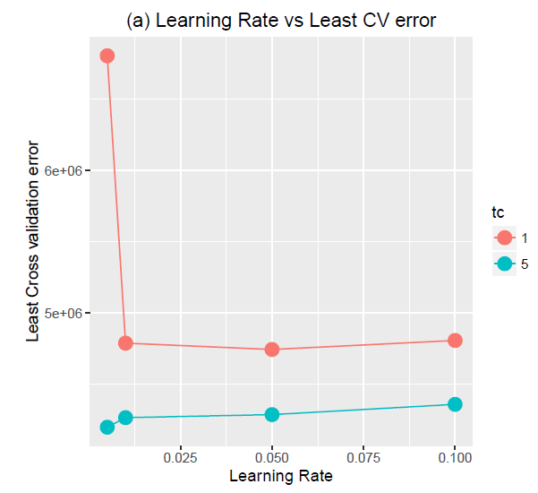
Boosted Regression Trees (BRT)
The gbm package of R was used to fit the BRT model.
The time to build BRT model on the complete training data set was taking 3 hours.
We randomly selected 30K observations and built BRT model and has chosen the optimal parameters (learning rate=0.01 and Tree complexity=5)
Identified 60 variables as the important variables in the data set
More information on BRT can be found in the additional information section

Slide 6
Rule fit
Used the RuleFit software (http://statweb.stanford.edu/~jhf/R_RuleFit.html) to fit the model
Identified 30 variables as the most important variables
The cross validation error and the run time are significantly greater than the BRT
Used the average interactions as 2, resample proportion as 0.6, and restricted the maximum rules to 500
On 30K sample, the algorithm ran for 2 hours, and on the whole training data for 6 hours
More information on Rule fit can be found in the additional information section

Slide 7
Challenges
The BRT algorithm has ran for 2 to 4 hours based on the tree depth and learning rate
The Rule Fit algorithm has run for 6 hours
Other tree based method - the Random Forest algorithm has never produced any model even after running the model for 24 hours
The Random Forest package of R cannot accept more than 51 levels in the categorical variables.
We avoided using Random Forest algorithm
The Rule Fit CV process has ran for 6 hours
The Rule Fit process ran for 2 hours on a sample size of 30000

Slide 8
Results
Method | 5 fold Cross Validation Score (Mean Squared Error) | Run time | Kaggle Score (Mean Absolute Error)
Boosted Tree regression | 3960867 | 3 hours appx | 1209
Rule Fit | 4328873 | 6 hours appx | 3860
18 out of top 20 variables identified by BRT and Rule fit matched, although their ranks were different.
BRT method found cat80 as the most important variable, while Rule fit found cat116 as the most important variable.
We selected the BRT as the best algorithm to fit the training data, based on the CV error and run-time

Slide 9
Future Work
Use AWS to train models and evaluate the Rule Fit performance for various parameters (average tree depth, sample size, maximum number of rules, learning rate)
Fit a linear model, perform mixed variable selection method, and compare if we obtain the same variables as identified in the Rule fit and BRT methods. Obtain the CV error of the linear model
Use xgboost to train the model and compare the performance with Rule fit and BRT

Slide 10
Q&A

Slide 11
Additional information
More information on BRT and Rule Fit follows…

Slide 12
Boosted Regression Trees
Decision trees are constructed iteratively and combined as parameters in a linear regression.
A tree in stage N will be fitted on the residuals of the model produced by the previous N-1 trees.
The optimal number of trees needed varies, based on the Learning Rate and tree depth (for interactions).
The algorithm will give you the list of important variables in the data set, as model output along with the important interactions

Slide 13
Rule fit method
Also based on decision trees (almost similar to Boosted Regression Trees but with the following differences)
The rules are extracted from the final ensemble model, and the rules are fit again using lasso.
Most of the unnecessary rules will be nullified.
The tree depth is randomly picked using an exponential distribution, and this will average the complexity
The algorithm will give you the list of important variables in the data set, as model output along with the important interactions

